Slide 1
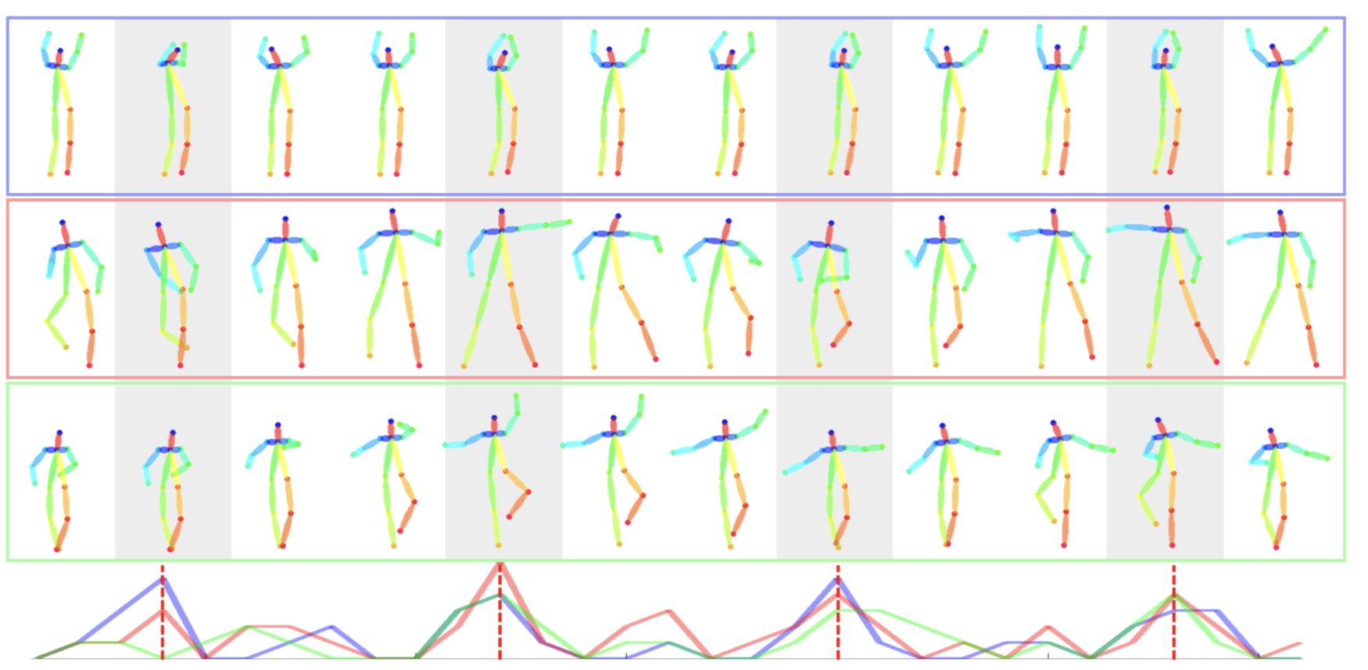
Dancing to Music
Han Yan, Weiyu Du
CIS 565 Final Project Milestone 2
Notes:
Hello everyone, today we’re going to present milestone 2 for our project Dancing to Music

Slide 2

Completed for MS2
Fix the bug on audio/dance generation length
Optimize codebase for training/inference efficiency
Merge loss functions and only do one backward pass in each iteration
Clean up unused computational graph to save memory
Compare different model architecture for recurrent units
Performance analysis on CPU vs GPU and varying batch size
Notes:
Here is a list of tasks we completed for milestone 2. Firstly, we fixed the bug mentioned last time. Before, we need to manually edit the video for it to have the same time span as the music. Now we have the correct results just from raw output of the network. Second part is a series of optimization we did to our code base in order to expedite training and inference. Firstly, we merged the loss functions and did only one backward pass through the network instead of three. Secondly, we cleaned up unused computational graph to free up more memory space on GPU card. Lastly, we experimented different model architecture for the recurrent units, which is a component that is frequently used in our framework. Eventually, we did some performance analysis on the time efficiency of using a GPU versus a CPU.

Slide 3
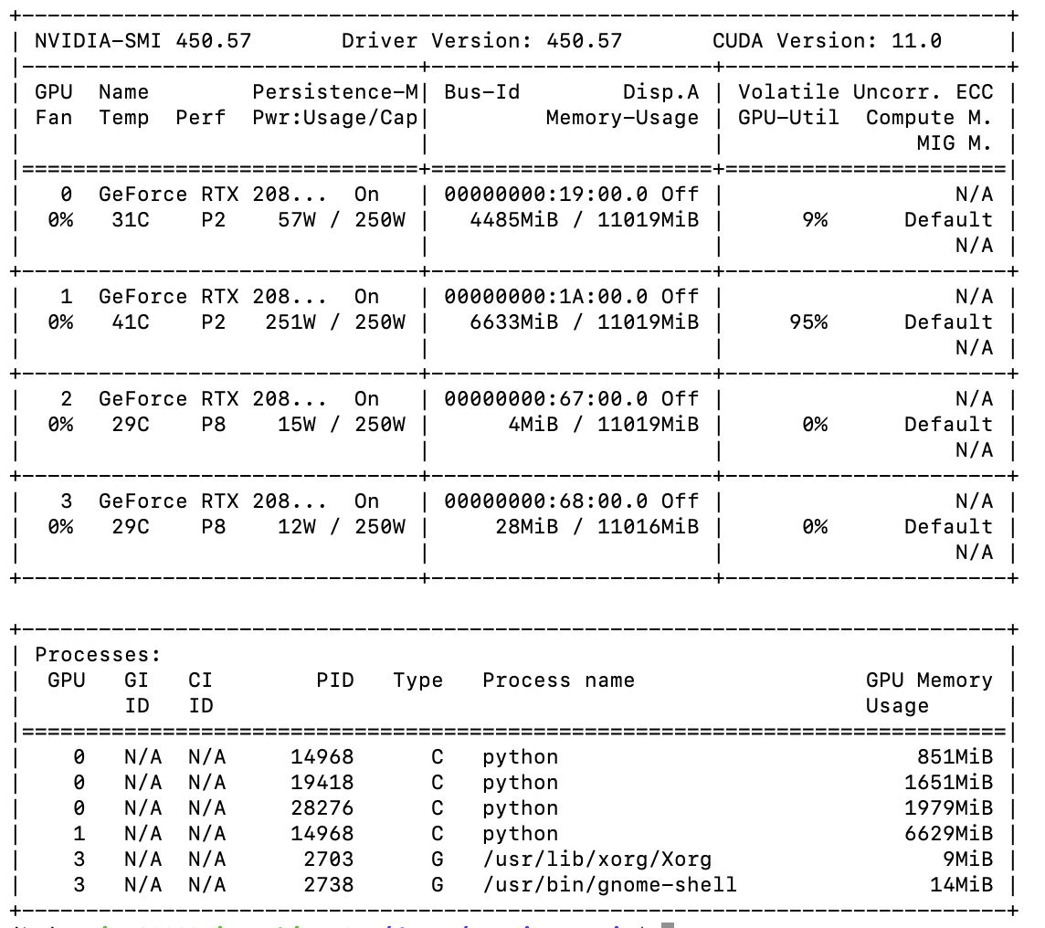
Peak into GPU performance!
Nvidia-smi provides monitoring and management capabilities for NVIDIA cards
GPU utilization: increase batch size to just achieve ~100%
Memory usage on the individual GPU card
Notes:
As starters, we used nvidia-smi to monitor the GPU card usage in our training. We can see the memory usage and also volitile GPU utilization. To get training done as fast as possible, we want to max our batch size to have 100% usage.

Slide 4
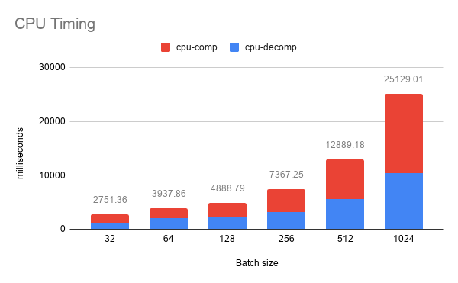
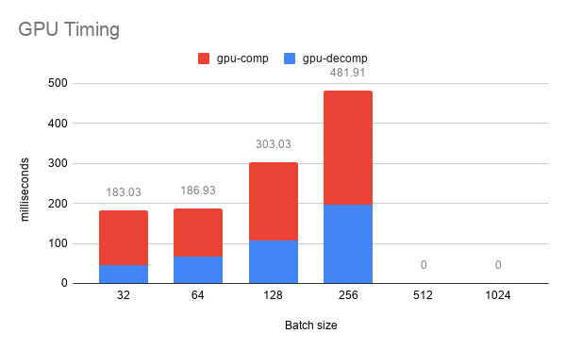
Comparison between CPU vs GPU with varying batch size, Training time
→ Part 1, forward & backward network pass
Increase with batch size
While GPU would take ~39 hours to complete 400 epochs for the training stage, CPU would need ~600 hours = 25 days!
However, GPU training is constricted by its memory. The one I’m using has 11.55 GB, which cannot fit with batch size>=512. Large batch size is often preferable in ML tasks.
Notes:
Now let me show you our performance analysis of the model. Here is the run time comparison for cpu versus gpu and with varying batch size. On the left is CPU and on the right is GPU. The x axis is batch size and y axis is in milliseconds per iteration. Here iteration refers to one network pass. For a more intuitive comparison, based on batch size 256, we computed the total time it would take to complete training on CPU and GPU. On GPU, it would take about 39 hours for both composition and decomposition stages. A pretty significant amount of time. But on CPU, it would take as much as 25 days.
However, a good thing about cpu is that we will not be constrained on our batch size. For example, the GPU card I’m using has about 12 GB, which cannot fit batch size of 512. Usually, larger batch size is preferable in ML tasks, because the model is less likely to overfit.

Slide 5
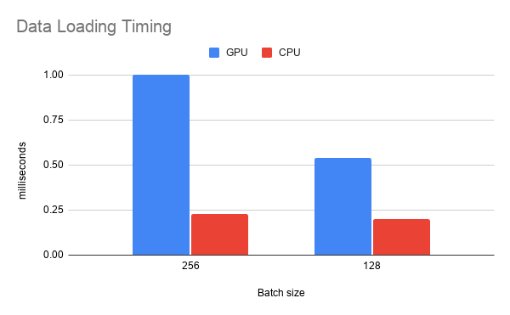
Comparison between CPU vs GPU with varying batch size, Training time
→ Part 2, data loading
Timed the data-loading operation, a typical bottleneck in deep learning, especially when it requires expensive CPU operations and high dimensional data.
In our case, poses and audio proves to be very lightweight, so we did not optimize it further.

Slide 6
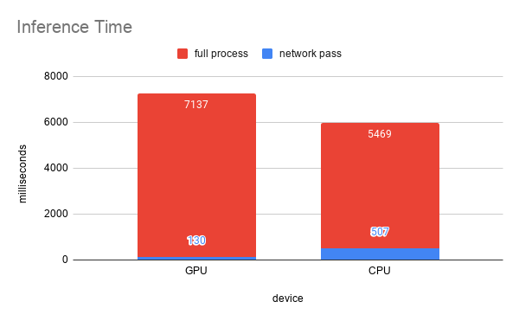
Comparison between CPU vs GPU, Inference Time
In a single network pass, GPU performs better than CPU. However, it has longer total inference time due to the time it needs to send all the models and data to GPU and back.
The full process also includes time to read from files and write to files, which proves to be the significant factor here.

Slide 7
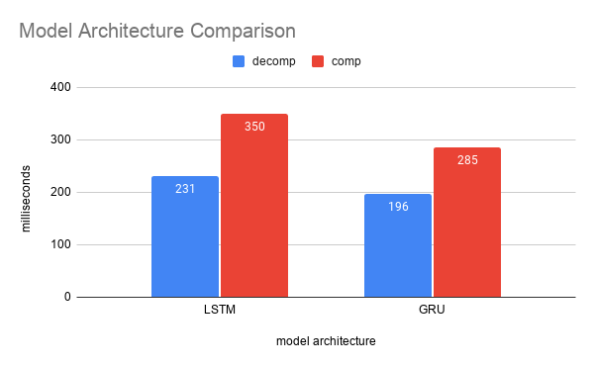
Comparison between Model Architecture, LSTM vs GRU
GRU has fewer gates compared to LSTM, and less model capacity. As expected, a simpler model architecture would yield faster training/inference time.
In our experiments, we chose GRU for all other configurations.

Slide 8
Goals for MS3
Improve articulation in dance movements
Literature review on other state of the art modes
Combine novelty in different methods and see if they work better together
Pose-to-Image translation
Given the predicted poses, train another network that maps the 2D poses to images of a person with simple background. So instead of having an unappealing stick figure dance, we would have an actual person dance!
Needs additional data to learn the mapping. Generation quality may not be that realistic to human eyes.

